Slide 1
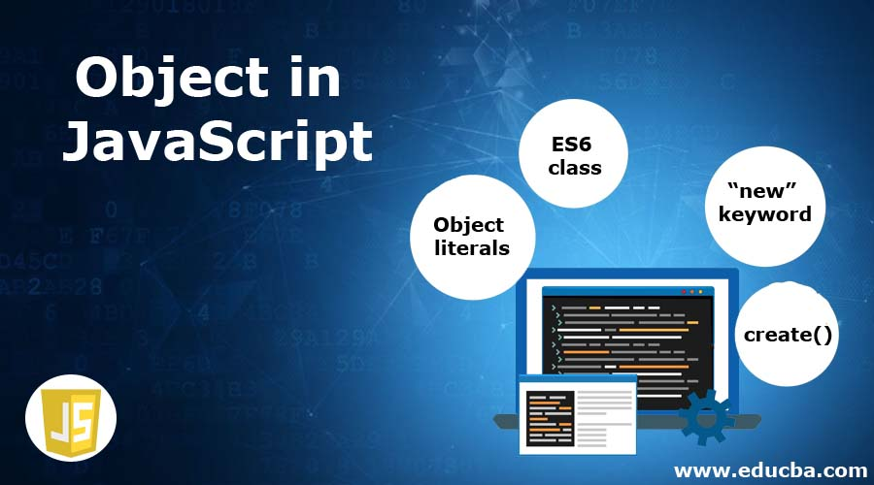

Slide 2
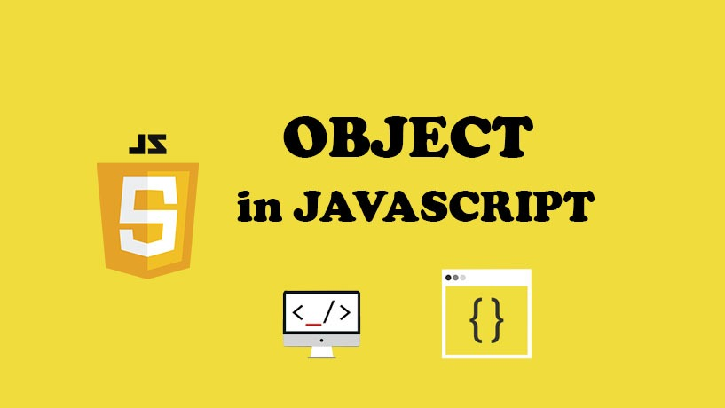

Slide 3
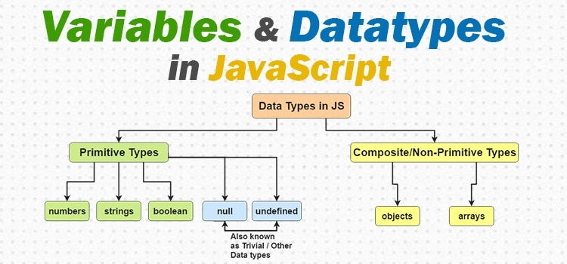

Slide 4
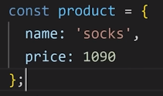
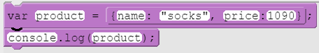

Slide 5
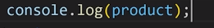
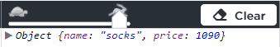

Slide 6
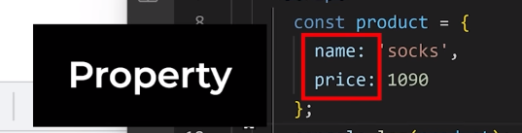
Using the properties we can access specific values within the objects

Slide 7
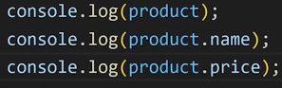
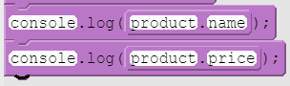
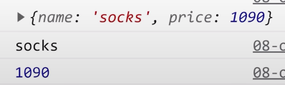

Slide 8
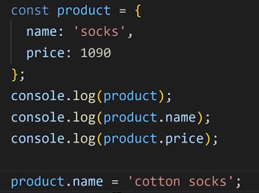
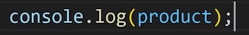
Changing the values inside the Objects

Slide 9
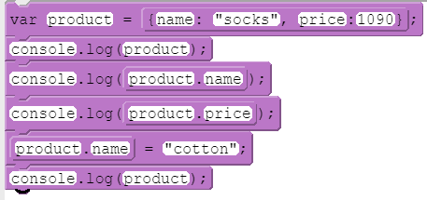
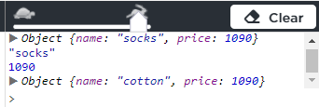

Slide 10
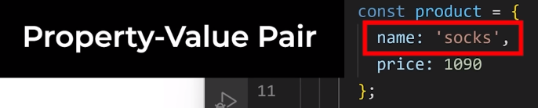
Syntax Rules for Objects
Inside the object we can put multiple values
We can access the values inside an object through properties
We separate property and value with the colon
We can have many property value pairs in an object and we separate them with the commas

Slide 11
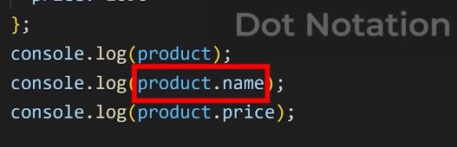

Slide 12
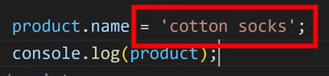
To change a value in an object

Slide 13
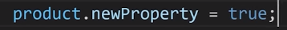
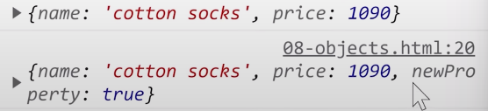
Adding a new Property any Data Type

Slide 14
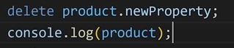
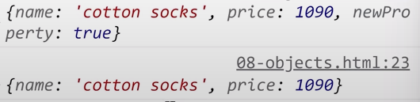
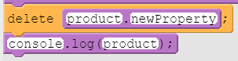
Remove a value from an Object using Delete

Slide 15

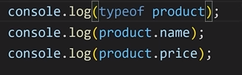

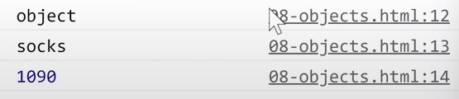

Slide 16
Advantage
We can group all the related values together into one object
Objects also allows us to use multiple values together
We can display the whole object in one time

Slide 17



Slide 18
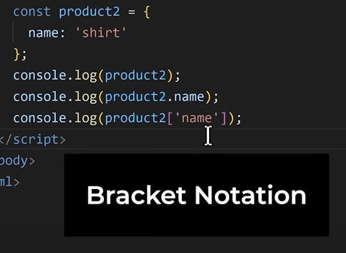
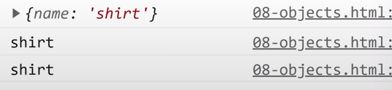
Another way of accessing the values in JavaScript [ ]

Slide 19

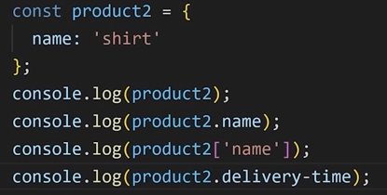
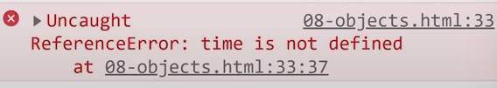
When to use bracket notation instead of Dot Notation

Slide 20
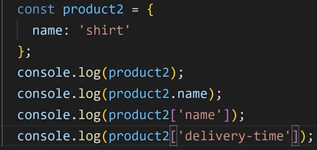
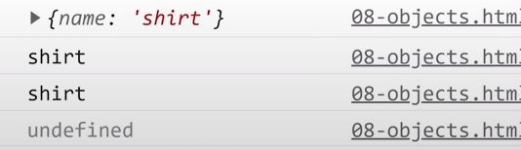

Slide 21
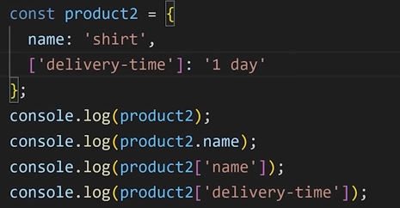
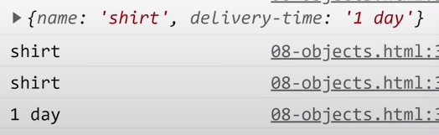
We also [] to add values to the object

Slide 22
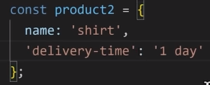
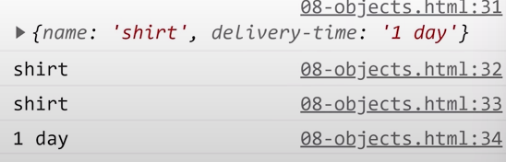
If just a string without any mathematical operator then the brackets are optional

Slide 23


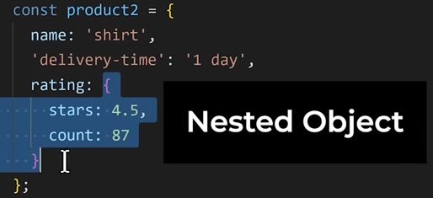
Nested Object : to make the object values more organised

Slide 24
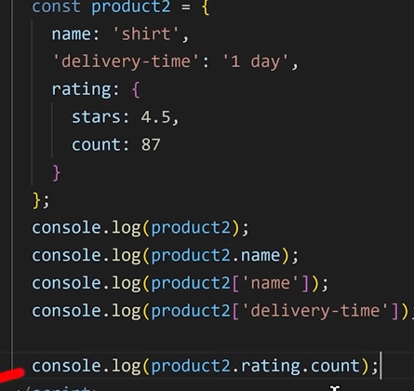
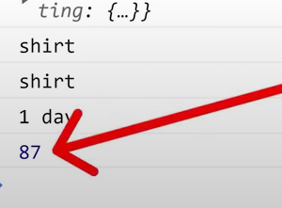
To access the values inside the inner objects, We just use the dot notation or bracket notation multiple times

Slide 25

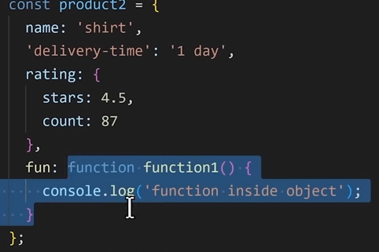
Function in an object

Slide 26
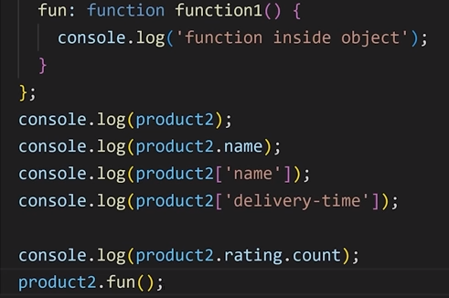
Use both dot or bracket notation to access the function

Slide 27
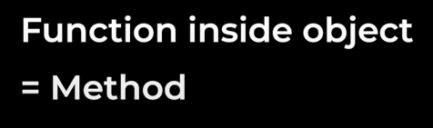
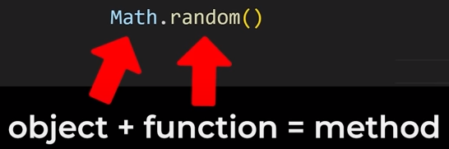
Method: when we call function inside an object

Slide 28
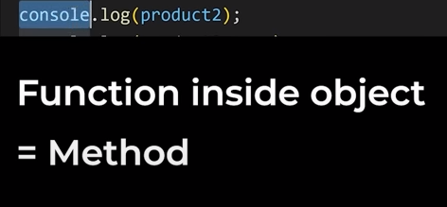
Console is an object provided by JavaScript and Log is a function that is saved inside the console

Slide 29

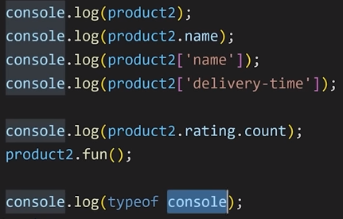
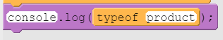
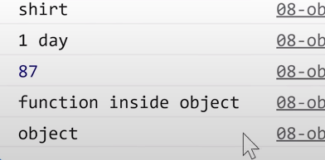
How to check if it is an object

Slide 30
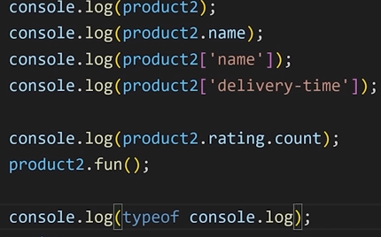
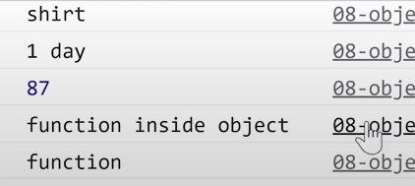

Slide 31

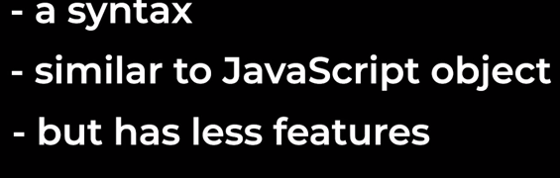
Built-in Objects

Slide 32


Slide 33
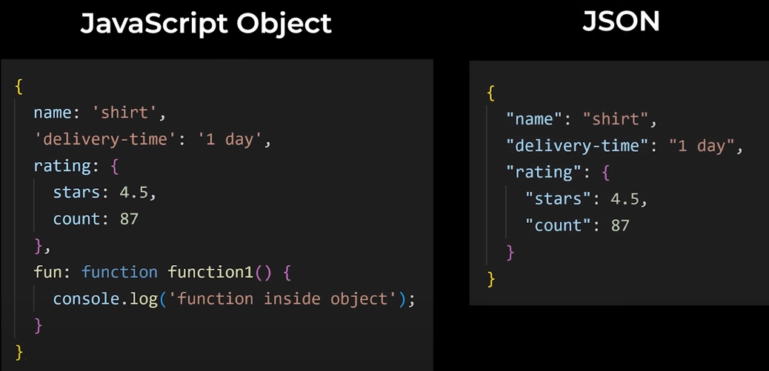

Slide 34

JSON Does not support Single quotes

Slide 35

JSON does not support function

Slide 36


Slide 37
Why we use JSON?
JSON is more Universal
JavaScript objects only makes sense in JavaScript
JSON Syntax can be understood by almost every programming language
We use JSON when we send data between computers which might use different programming languages
We also use JSON when we store Data

Slide 38

Built-in JSON Objects

Slide 39

Convert Javascript objects into JSON Objects stringify()

Slide 40



Slide 41


Parse()

Slide 42

Localstorage(): Permanent storage
How to store data
When we reset or launch the app again the data lost,
LocalStorage does not get deleted when refresh
Create local storage object and apple methods

Slide 43

LocalStorage()
How to retrieve data
getItem() Method gets a value out of local storage
Local storage only store string so any data type has to be converted into String
We need to use JSON.stringify() to convert it into appropriate data

Slide 44

Remove data from LocalStorage removeItem()
Just removing does not help, If the values is in use in the script it will be treated as NULL and if it was in use in any mathematical calculations it will give an error
To solve this issue provide a default value to the parameter

Slide 45


For reassigning value you cannot use constant , instead use let

